Slide 1
Relational Algebra
CS364

Slide 2


Relation
A relation is a two dimensional table that
  Rows contain data about an entity
  Columns contains data about attributes of the entity
  Cells of the table hold a single value
  All entries in a column are of the same kind
  Each column has a unique name
  The order of the columns is unimportant
  The order of the rows is unimportant
  No two rows may be identical

Slide 3
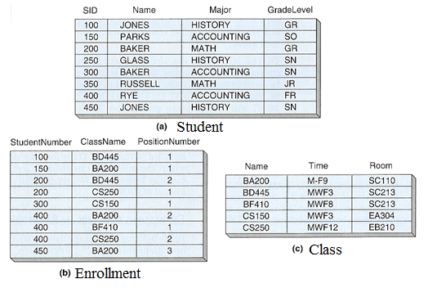
Example of Relations

Slide 4
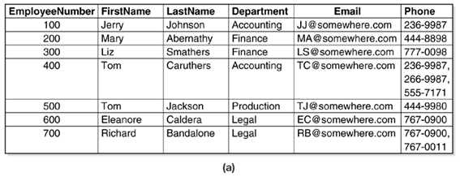
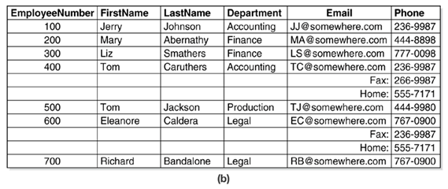
Example: Tables Not Relations
Why?
Why?

Slide 5
Relational Algebra
Defines operations that work on relations to achieve the desired results
The exercise allows people to better understand relational databases and SQL
It is closed, meaning the operands are relations and so are the results
It is an example of DML (Data Manipulation Language)

Slide 6
The Eight Relational Operations
Union
Difference
Intersection
Product
Selection
Projection
Join
Rename

Slide 7
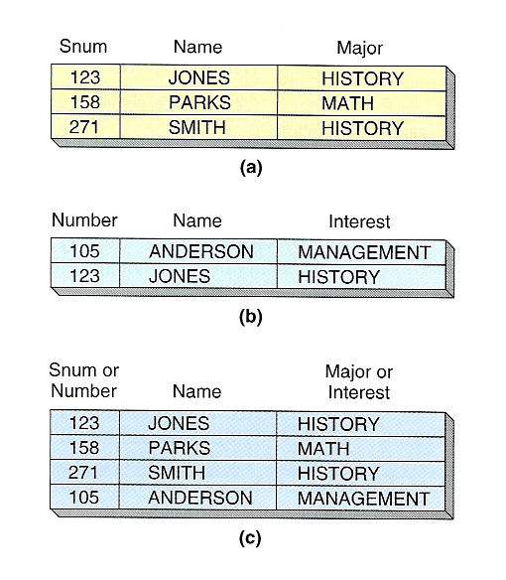
Union
The union of two relations A and B is formed by adding the rows from one relation to those of a second relation to produce a third relation with duplications removed
It is denoted as A+B.

Slide 8

Union Compatible
Two relations are union compatible if
  The two relations have the same number of columns
  The corresponding columns have the same domain

Slide 9
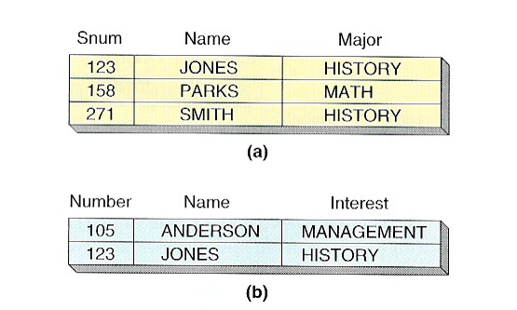
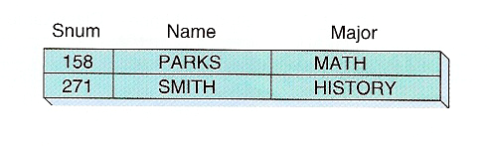
Difference
The Difference of two relations A and B contains all the rows in A but not in B.
A and B must be union compatible
It is denoted as A – B
The difference of a-b on the right is c
A – B ≠ B - A
(c)

Slide 10
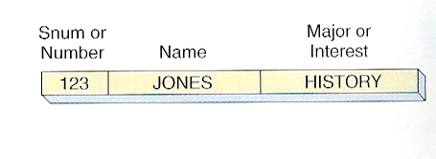
Intersection
The Intersection of two relations A and B contains all the rows in both A and B.
A and B must be union compatible
It is denoted as A Intersection B
The Intersection of A and B, denoted as A Intersect B, on the right is c
(c)

Slide 11
Product
Also called Cartesian product, denoted as A X B
The Product of two relations A and B contains the concatenation of every row in A with every row in B.
If there are 100 2K rows in A and 5000 5K rows in B, the product of A and B is a relation of 100X5000 rows of (2K+5K) records
A and B do not need to be union compatible
In SQL, Select * from A, B gives the product of A and B (Try it out yourselves)

Slide 12
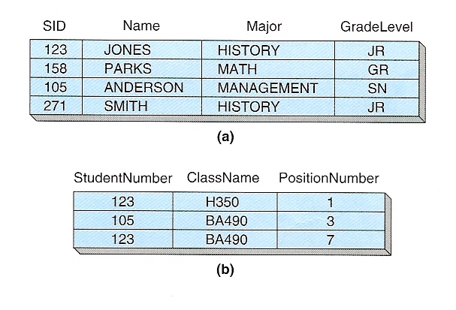
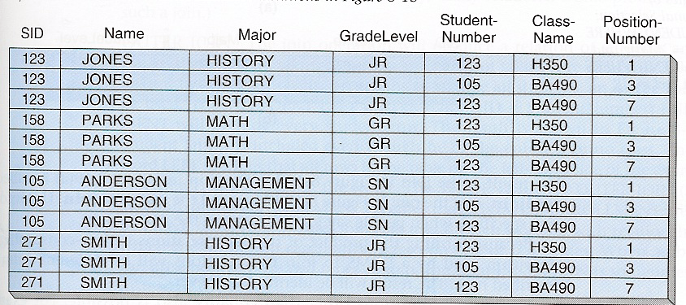
Product Example
A: STUDENT
C: PRODUCT of A and B
B: ENROLLMENT

Slide 13
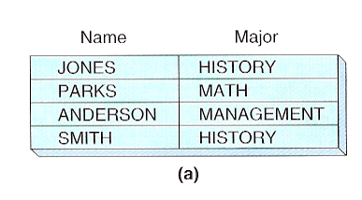
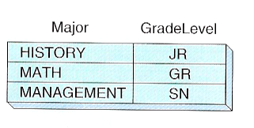
Projection
The Project operation is applied on a single relation.
It selects specified attributes from a relation with duplications removed
The example on the right is a projection on the STUDENT relation’s major and GradeLevel attributes, represented as STUDENT[Major, GradeLevel]
Notice the removal of duplicated rows as the result of projection
A: STUDENT

Slide 14
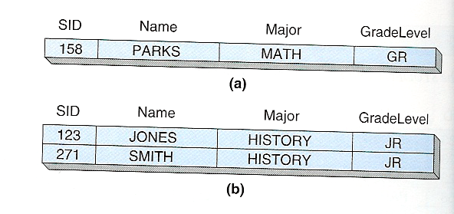
Selection
The Selection operation is applied on a single relation.
It selects specified rows from a relation based on the given condition
The examples on the right are the results of
(a) STUDENT where major = ‘MATH’
(b) STUDENT where GradeLevel = ‘JR”
A: STUDENT

Slide 15
Join
The Join operation is a Product followed by a Selection
It is this concept of JOIN, inherited from Product, that connects rows in two different relations together, side by side, so you can compare or pull information from the two
There are two types of joins: equijoin and natural join
  A NATURAL JOIN is a join operation that creates an implicit join clause for you based on the common columns in the two tables being joined. Common columns are columns that have the same name in both tables .

Slide 16
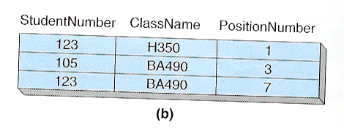
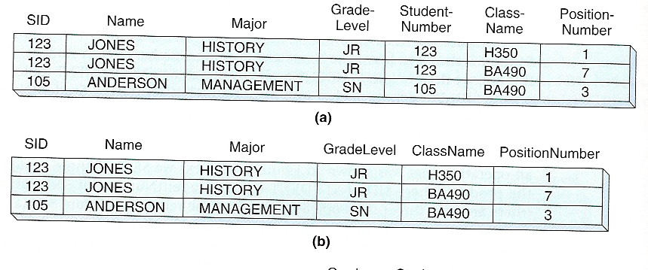
Join Examples
A: STUDENT
B: ENROLLMENT
Equijoin
Natural Join If B relation’s StudentNumber were named as SID
STUDENT Join ENROLLMENT on SID = StudentNumber

Slide 17
Rename
If we have to use multiple copies of the same relation in an relational algebra expression, how can we tell the difference between two copies of the same relation? We use rename.
We borrow SQL notation with A as B. Now we have two copies of A, except we call the second copy B. B should not be a relation alredy exists.

Slide 18
Examples Of Relational Algebra
The relations on the right will be used in the examples

Slide 19
Examples Of Relational Algebra
What are the names used by students?
What are the student numbers of all students enrolled in a class?
What are the student numbers of all students not enrolled in a class?
What are the student numbers of all students enrolled in ‘BD445’?
What are the student names of students enrolled in ‘BD445’?
What are the names and meeting times of ‘PARKS classes
What are the names of the students who have a class at the same time as ‘BAKERs’

Slide 20
Example (1)
What are the names used by students
This is an example of Projection, just about the simplest operation
STUDENT[Name]

Slide 21
Example (2)
What are the student numbers of all students enrolled in a class?
This is another example of Projection
ENROLLMENT[StudentNumber]

Slide 22
Example (3)
What are the student numbers of all students not enrolled in a class?
This needs a little thinking …
We know all the student IDs and IDs of all students taking a class, right?
The Difference is the answer
STUDENT[SID] - ENROLLMENT[StudentNumber]
We have to perform the DIFFERNCE operation on two UNION Compatible sets!!!

Slide 23
Example (4)
What are the student numbers of all students enrolled in ‘BD445’?
This is an example of Selection because only a few records satisfies the condition
(ENROLLMENT where ClassName=‘BD445’ ) [StudentNumber]

Slide 24
Example (4.b)
What are the student numbers of all students not enrolled in BD445?
This is not the answer !!!
ENROLLMENT where ClassName != ‘BD445’
Instead,
STUDENT[SID] – (ENROLLMENT where ClassName = ‘BD445’) [StudentNumber]

Slide 25
Example (5)
What are the student names of all students enrolled in ‘BD445’?
The student names are in STUDENT relation
The information about who is taking which class is in the ENROLLMENT relation
How to put the two together?
→ JOIN
STUDENT Join ENROLLMENT on SID=StudentNumber where ClassName = ‘BD445’[STUDENT.NAME]

Slide 26
Example (5)
What are the student names of all students NOT enrolled in ‘BD445’?
Try to see if you can get this one.

Slide 27
Example (6)
What are the names and meeting times of ‘PARKS’ classes
Again, JOIN, JOIN, and more JOIN
Two possible approaches
  Select as much as one can at the earliest possible time
    (STUDENT where name = ‘PARKS’ Join ENROLLMENT on SID = StudentNumber ) Join CLASS on ClassName = CLASS.NAME [CLASS.NAME, Time]
  Join all then select
    STUDENT Join ENROLLMENT on SID = StudentNumber Join CLASS on ClassName = CLASS.NAME where STUDENT.name = ‘PARKS’ [CLASS.NAME, Time]
Which is a better solution?
First one? Why?

Slide 28
Example (7)
What are the names of BAKER’s classmates.
Translate: List the names used by all students who take at least one class with a student who’s name is BAKER.
This is a hard one.
First, there are two BAKERs. Second, how do we express this “taking the same class?”

Slide 29
Example (7 - 2)
Let’s try this one first: List the student numbers of the students taking a class with the student whose number is 200.
Note that we refer the same table twice using Rename
ENROLLEMENT where studentNumber = 200 JOIN ENROLLMENT as E2 on ENROLLMENT.ClassName = E2.ClassName [E2.StudentNumber]

Slide 30
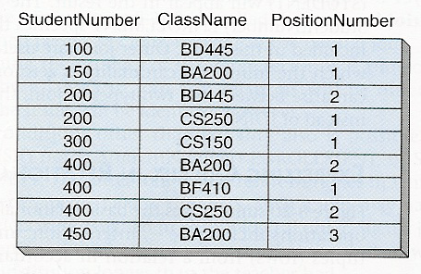
Example (7-3)
ENROLLMENT
ENROLLMENT as E2

Slide 31
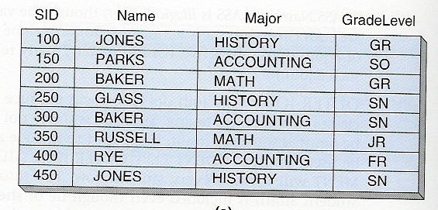
Example (7-4)
E2
S
S2
E
JONES
RYE

Slide 32
Example (7-Answer)
What are the names of the students BAKER’s classmates
  S Where S.NAME = ‘BAKER’
  Join E on S.SID=E.StudentNumber
  Join E as E2 on E.ClassName = E2.ClassName
  Join S as S2 on E2.StudentNumber = S2.SID
  Where S2.SID != S.SID [S2.Name]

Slide 33
One More
If two students have the same name, list the name and the two student IDs
S join S as S2 on S.Name = S2.Name and S.SID < S2.SID [S.Name, S.SID, S2.SID]

Slide 34
References
http://www.databasteknik.se/webbkursen/relalg-lecture/
https://db.grussell.org/section011.html
https://www.youtube.com/watch?v=FTrqsCWKfrw (I have mixed feelings on this one, on one hand, it explains the operations, on the other hand, it tries to link SQL with relational algebra. Algebra is the theory, SQL is more exactly the same as relational Algebra. For example, the result of an SQL statement is not a relation!!!)

